Slide 1

BABD A Bitcoin Address Behavior Dataset for Pattern Analysis

Slide 2
Contents of the presentation
Project Description
Problem Statement
Objective
Scope
Literature Survey
Significant
Proposed System
Architecture
Resource Requirements
Research Gap analysis
Implementation
1. Data Description
Model Implementation
1. Algorithm Definition
Reference

Slide 3
Project Description
This study focuses on time series analysis for predicting Bitcoin prices using various methodologies, including Recurrent Neural Networks (RNN), Long Short-Term Memory networks (LSTM), Auto Regressive Integrated Moving Average (ARIMA), and Facebook's Prophet. We utilize a dataset consisting of timestamps and closing prices to train and evaluate the performance of these models. The objective is to identify the most effective forecasting technique for Bitcoin price movements, addressing the inherent volatility of cryptocurrency markets. By leveraging historical price data, we aim to enhance prediction accuracy, contributing to more informed trading decisions. Our findings will provide valuable insights into the applicability of different predictive models in the context of cryptocurrency, ultimately aiming to assist investors in navigating the complexities of Bitcoin trading. The results underscore the strengths and weaknesses of each method, paving the way for future research in financial time series analysis.
Keywords: RNN, LSTM, ARIMA and Prophet, Kaggle dataset.

Slide 4
Problem Statement
The cryptocurrency market, particularly Bitcoin, is characterized by high volatility, making accurate price prediction a significant challenge for investors. Traditional forecasting methods often struggle to adapt to the dynamic nature of these markets. This study aims to explore the effectiveness of various time series analysis techniques, including RNN, LSTM, ARIMA, and Facebook's Prophet, to predict Bitcoin prices. By employing a dataset of historical timestamps and closing prices, we seek to determine which methodology yields the most accurate forecasts, ultimately providing insights that can aid investors in making informed trading decisions amidst market fluctuations.

Slide 5
Objective of the Project
The primary objective of this project is to conduct a comprehensive time series analysis for predicting Bitcoin prices by comparing various forecasting methodologies, including RNN, LSTM, ARIMA, and Facebook's Prophet. We aim to utilize historical closing price data to develop and evaluate these models, with a focus on enhancing prediction accuracy amidst the inherent volatility of the cryptocurrency market. By identifying the most effective predictive technique, this study seeks to provide insights that will assist investors in making informed trading decisions, thereby contributing to a deeper understanding of financial time series analysis in the context of cryptocurrency.

Slide 6
Scope
This study explores the application of time series analysis techniques for predicting Bitcoin prices, focusing on RNN, LSTM, ARIMA, and Prophet models. By utilizing a comprehensive dataset of timestamps and closing prices, we aim to evaluate each model's performance in forecasting Bitcoin price movements amidst market volatility. The research will examine the strengths and weaknesses of these methodologies, offering insights into their effectiveness in cryptocurrency trading. Additionally, the findings will serve as a foundation for future studies in financial time series analysis, enabling investors to make data-driven decisions in an increasingly complex trading environment.

Slide 7
Literature Survey
S.NO | YEAR | AUTHORS | TITLE | OUT COMES
1 | 2022 | L. Serena, S. Ferretti, and G. D’Angelo. | Cryptocurrencies activity as a complex network: Analysis of transactions graphs. | The authors introduce the Distributed Ledger Network Analyzer (DiLeNA), a tool designed to investigate transaction networks. Their findings reveal that transaction graphs across all studied DLTs exhibit small-world properties, highlighting the importance of network analysis for understanding user interactions and the dynamics of cryptocurrency ecosystems.
2 | 2021 | B. Tao, I. W. Ho, and H.-N. Dai. | Complex network analysis of the Bitcoin blockchain network. | Using machine learning models like k-nearest neighbors, decision tree, and XGBoost, they achieve classification accuracies between 93.24% and 97.13%. Additionally, the study proposes a k-hop subgraph generation algorithm for in-depth network analysis and examines Bitcoin address behavior patterns, contributing to better understanding and tracking of blockchain transactions.

Slide 8
S.NO | YEAR | AUTHORS | TITLE | OUT COMES
3 | 2022 | B. Tao, H.-N. Dai, J. Wu, I. W. Ho, Z. Zheng, and C. F. Cheang | Complex network analysis of the Bitcoin transaction network | A novel subgraph generation algorithm, BTC-SubGen, extracts k-hop subgraphs from the Bitcoin transaction network. Classification using various machine learning models achieved accuracy rates between 93.24% and 97.13%. The study also explores feature importance and behavior patterns of Bitcoin addresses.
4 | 2021 | N. Tovanich, N. Soulié, N. Heulot, and P. Isenberg. | An empirical analysis of pool hopping behavior in the Bitcoin blockchain. | The study finds that while pool-hopping remains beneficial, the newer reward systems have improved fairness, reducing the disparity between pool-hoppers and static miners. Despite this, pool-hoppers still achieve a 33% higher median cumulative gain compared to static miners.

Slide 9
S.NO | YEAR | AUTHORS | TITLE | OUT COMES
5 | 2020 | I. Alqassem, I. Rahwan, and D. Svetinovic. | The anti-social system properties: Bitcoin network data analysis. | The Author Index details the primary entries for each item, organized by the first author’s name, and includes coauthors, paper titles, and publication specifics. The Subject Index categorizes entries by relevant subject headings, providing comprehensive bibliographic information. The focus of the paper is on analyzing Bitcoin’s network dynamics and its implications within an anti-social system framework.
6 | 2021 | P. Nerurkar, D. Patel, Y. Busnel, R. Ludinard, S. Kumari, and M. K. Khan. | Dissecting Bitcoin blockchain: Empirical analysis of Bit- coin network (2009–2020). | The study delves into the network’s local topology and geometry to understand how these social and antisocial characteristics influence Bitcoin's development. By analyzing transaction data from Bitcoin’s initial decade, the authors provide insights into the network's structural dynamics and how user behaviors shape its growth and challenges.

Slide 10
Significant
1. Diverse Methodologies: The study employs RNN, LSTM, ARIMA, and Prophet to forecast Bitcoin prices, highlighting the range of techniques available for time series analysis.
2. Volatility Focus: It addresses the challenges posed by the inherent volatility of cryptocurrency markets, which is crucial for accurate price prediction.
3. Dataset Utilization: The research utilizes a comprehensive dataset of timestamps and closing prices, ensuring robust model training and evaluation.
4. Prediction Accuracy: The primary objective is to enhance prediction accuracy, which can lead to more informed trading decisions for investors.
5. Insights for Future Research: Findings will provide insights into the strengths and weaknesses of each predictive model, contributing to ongoing advancements in financial time series analysis.

Slide 11
Proposed System
This study proposes a comprehensive system for predicting Bitcoin prices through time series analysis. By implementing various forecasting models—RNN, LSTM, ARIMA, and Facebook's Prophet—we will analyse historical price data to assess each model's effectiveness. The system will utilize a Kaggle dataset containing timestamps and closing prices, allowing us to train and evaluate the performance of the different methodologies. Our approach aims to enhance prediction accuracy amidst Bitcoin's volatility, offering insights into the strengths and limitations of each technique. Ultimately, the system seeks to aid investors in making informed trading decisions within the cryptocurrency market.

Slide 12
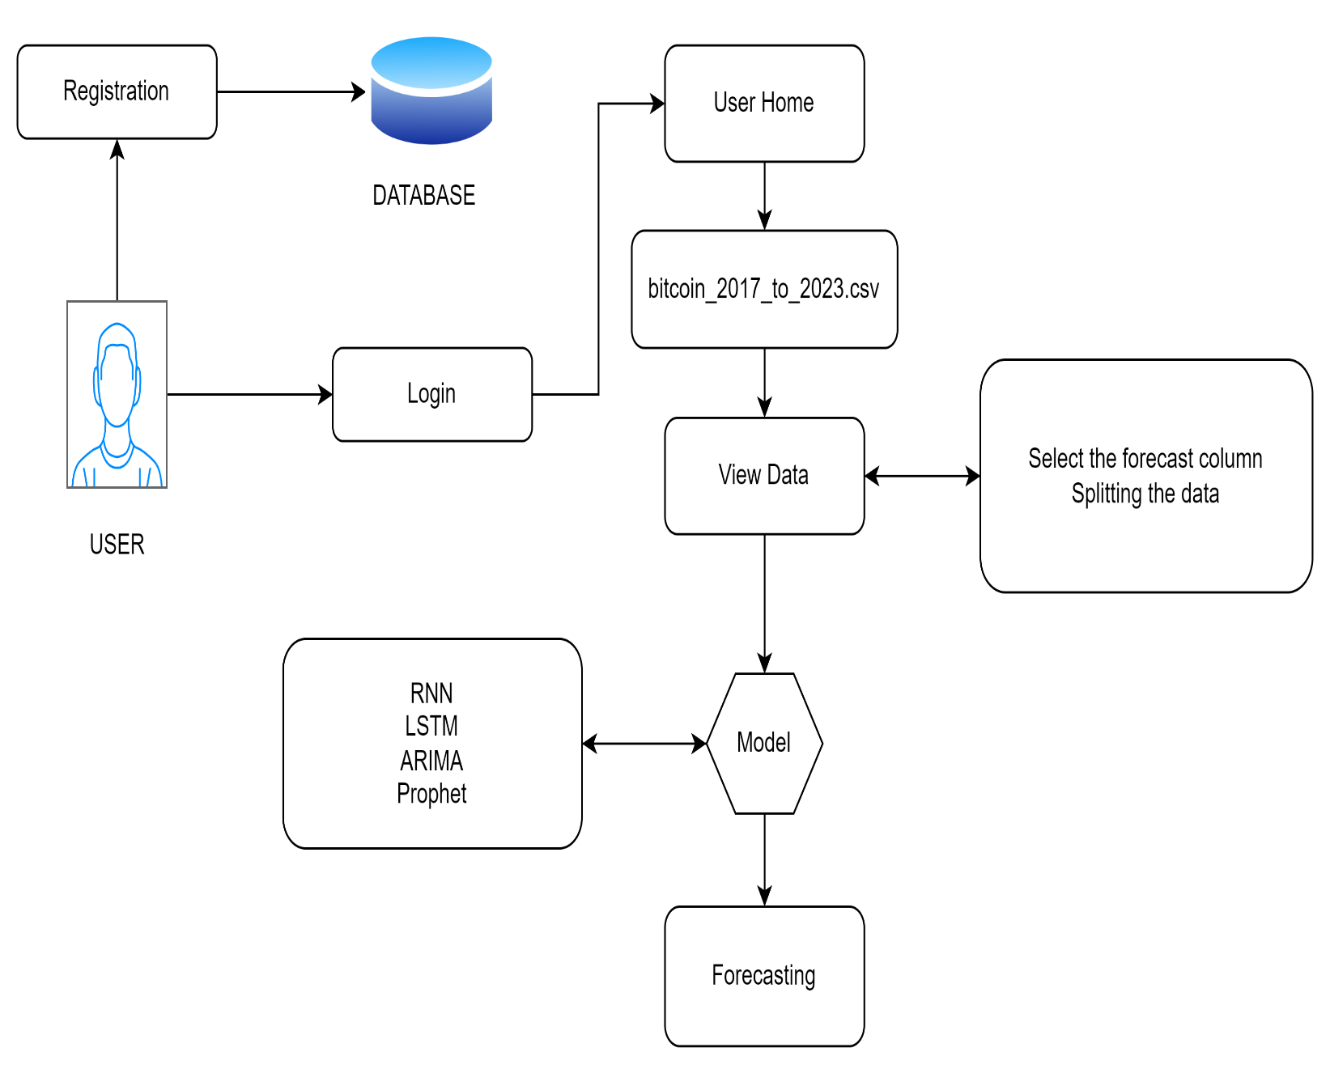
Architecture

Slide 13
Resource Requirements
01
Hardware
(Processor: I5/Intel Processor, RAM: 8GB (min), Hard Disk: 128 GB, Key Board: Standard Windows Keyboard, Mouse: Two or Three Button Mouse)
Resources
02
Software
(Operating System: Windows 10, Programming Language: Python 3.10.8, IDE: VS Code)
03
Packages/Libraries
(Streamlit, Sklearn, Transformers, Tensorflow, Pandas, Seaborn, Speech Recognition

Slide 14
Research Gap analysis
Model Comparisons: Limited studies systematically compare the performance of traditional statistical models (ARIMA) with advanced machine learning models (RNN, LSTM) and Prophet in Bitcoin price prediction.
Impact of Market Events: Few studies incorporate external market events or news sentiment analysis to evaluate their influence on Bitcoin price fluctuations and model performance.
Handling Volatility: There is a lack of comprehensive approaches that specifically address the volatility of cryptocurrency markets when developing predictive models.
Temporal Dynamics: Research often overlooks the exploration of time-varying patterns and trends within Bitcoin price movements, which can enhance predictive accuracy.

Slide 15
Implementation
Data Analysis
Model Implementation
01
Data Description
04
Algorithm Definition
02
EDA Explanation
05
Working Process
03
Preprocessing steps
06
Results from Algorithm

Slide 16
Data Description
Dataset: https://www.kaggle.com/datasets/jkraak/bitcoin-price-dataset
The dataset utilized in this study comprises historical Bitcoin trading data, specifically focusing on timestamps and closing prices. Each entry records critical metrics, including the opening, high, low, and closing prices, along with trading volume, quote asset volume, and the number of trades conducted. The data spans multiple time intervals, providing a comprehensive view of market fluctuations. This extensive dataset serves as the foundation for training and evaluating various predictive models, including RNN, LSTM, ARIMA, and Facebook's Prophet, allowing for an in-depth analysis of Bitcoin price trends and volatility within the cryptocurrency market.

Slide 17
Algorithm Definition
Recurrent Neural Networks (RNNs):
Recurrent Neural Networks (RNNs) are a powerful class of neural networks designed for sequential data, making them suitable for time series analysis, including Bitcoin price prediction. Unlike traditional feedforward networks, RNNs have connections that loop back on themselves, allowing them to maintain a memory of previous inputs. This feature enables RNNs to capture temporal dependencies in the data, which is crucial for predicting future price movements based on historical trends.
In the context of Bitcoin price prediction, RNNs can learn complex patterns from historical price data, trading volumes, and other relevant features. By processing the data sequentially, RNNs can adjust their predictions based on the sequence of past values, providing more accurate forecasts. Variants of RNNs, such as Long Short-Term Memory (LSTM) networks, enhance this capability by mitigating issues like vanishing gradients, enabling the model to retain information over longer periods. Overall, RNNs offer a promising approach for analysing and predicting Bitcoin prices effectively.

Slide 18
LSTM
Long Short-Term Memory (LSTM) networks are a specialized type of recurrent neural network (RNN) designed to capture temporal dependencies in sequential data. In the context of Bitcoin price prediction, LSTM models excel due to their ability to retain information over extended periods, effectively handling the intricacies of price movements influenced by various factors. The architecture includes memory cells that allow the network to learn from historical data while mitigating the vanishing gradient problem commonly encountered in traditional RNNs. By training on past Bitcoin prices and relevant market indicators, LSTM can discern patterns and trends, enabling more accurate forecasts. The model's capacity to adapt to non-linear relationships makes it particularly suitable for financial time series, where price dynamics can be erratic. Evaluating the performance of LSTM against other forecasting models can provide insights into its effectiveness in predicting Bitcoin prices, contributing to enhanced investment strategies and decision-making in the cryptocurrency market.

Slide 19
ARIMA:
ARIMA (Auto Regressive Integrated Moving Average) is a widely used statistical method for time series forecasting, particularly effective for analyzing and predicting Bitcoin prices. The ARIMA model combines three components: auto regression (AR), differencing (I), and moving average (MA). The autoregressive part captures the relationship between an observation and a number of lagged observations, while the moving average component accounts for the dependency between an observation and a residual error from a moving average model applied to lagged observations. Differencing is used to make the time series stationary, ensuring constant mean and variance over time. This method is advantageous for Bitcoin price prediction due to its ability to model trends and seasonality in volatile financial markets. By optimizing the model parameters (p, d, q), analysts can create robust forecasts, making ARIMA a valuable tool for investors and researchers aiming to understand Bitcoin price dynamics and trends.

Slide 20
Prophet:
Prophet is an open-source forecasting tool developed by Facebook, designed to handle time series data that exhibits trends and seasonality. It is particularly effective for data with strong seasonal effects and several seasons of historical data, making it a suitable choice for predicting Bitcoin prices. Prophet utilizes an additive model, which means it decomposes the time series into three main components: trend, seasonality, and holidays. The trend component captures the overall direction of the data, while the seasonal component accounts for periodic fluctuations. One of the standout features of Prophet is its ability to accommodate missing data and outliers, which are common in financial time series. With a user-friendly interface and flexibility in handling various forecasting scenarios, Prophet allows analysts and researchers to generate reliable predictions for Bitcoin price movements, helping investors make informed decisions based on historical trends and patterns.

Slide 21
Reference
[1] I. Alqassem, I. Rahwan, and D. Svetinovic, “The anti-social system properties: Bitcoin network data analysis,” IEEE Trans. Syst., Man, Cybern., Syst., vol. 50, no. 1, pp. 21–31, Jan. 2020. [11] J. Kim, J. Kim, H. Kim, M. Shim, and E. Choi, ‘‘CNN-based network intrusion detection against denial-of-service attacks,’’ Electronics, vol. 9, no. 6, p. 916, Jun. 2020.
[2] P. Nerurkar, D. Patel, Y. Busnel, R. Ludinard, S. Kumari, and M. K. Khan, “Dissecting Bitcoin blockchain: Empirical analysis of Bit- coin network (2009–2020),” J. Netw. Comput. Appl., vol. 177, Mar. 2021, Art. no. 102940.
[3] M. K. Popuri and M. H. Gunes, Empirical Analysis of Crypto Curren- cies. Berlin, Germany: Springer, 2016, pp. 281–292.
[4] D. Ron and A. Shamir, “Quantitative analysis of the full Bitcoin transaction graph,” in Proc. Int. Conf. Financial Cryptography Data Secur. Cham, Switzerland: Springer, 2013, pp. 6–24.

Slide 22
[5] L. Serena, S. Ferretti, and G. D’Angelo, “Cryptocurrencies activity as a complex network: Analysis of transactions graphs,” Peer-Peer Netw. Appl., vol. 15, no. 2, pp. 839–853, Mar. 2022.
[6] B. Tao, I. W. Ho, and H.-N. Dai, “Complex network analysis of the Bitcoin blockchain network,” in Proc. IEEE Int. Symp. Circuits Syst. (ISCAS), May 2021, pp. 1–5.
[7] B. Tao, H.-N. Dai, J. Wu, I. W. Ho, Z. Zheng, and C. F. Cheang, “Complex network analysis of the Bitcoin transaction network,” IEEE Trans. Circuits Syst. II, Exp. Briefs, vol. 69, no. 3, pp. 1009–1013, Mar. 2022.
[8] S. Ranshous et al., “Exchange pattern mining in the Bitcoin transaction directed hypergraph,” in Financial Cryptography and Data Security. Sliema, Malta: Springer, 2017, pp. 248–263.
[9] M. Romiti, A. Judmayer, A. Zamyatin, and B. Haslhofer, “A deep dive into Bitcoin mining pools: An empirical analysis of mining shares,” 2019, arXiv:1905.05999.
[10] N. Tovanich, N. Soulié, N. Heulot, and P. Isenberg, “An empirical analysis of pool hopping behavior in the Bitcoin blockchain,” in Proc. IEEE Int. Conf. Blockchain Cryptocurrency, May 2021, pp. 1–9.

Slide 23
THANK YOU

